Slide 1

Introduction to Machine Learning
Model Performance
By <Trainer’s Name>
<Date>

Slide 2
Cross-Validation
<Topic>

Slide 3

Cross-Validation
Split original set of examples, train
Examples D
-
+
-
-
+
-
-
-
-
+
+
+
+
-
-
+
Train
+
+
+
-
-
-
+
+
Hypothesis space H

Slide 4
Cross-Validation
Evaluate hypothesis on testing set
Testing set
-
-
-
-
+
+
+
+
+
+
-
-
+
Hypothesis space H

Slide 5
Cross-Validation
Evaluate hypothesis on testing set
Testing set
-
+
+
-
+
+
+
Train
-
+
+
-
-
-
Hypothesis space H

Slide 6
Cross-Validation
Compare true concept against prediction
9/13 correct
Testing set
-
-
-
+
-
+
-
-
+
+
+
+
+
+
+
-
+
+
+
+
-
-
-
-
+
-
Hypothesis space H

Slide 7
Common Splitting Strategies
k-fold cross-validation
Dataset
Train
Test

Slide 8
Common Splitting Strategies
k-fold cross-validation
Leave-one-out (n-fold cross validation)
Dataset
Train
Test

Slide 9
Regularization
<Topic>

Slide 10
Regularization
Let the learner penalize the inclusion of new features vs. accuracy on training set
A feature is included if it improves accuracy significantly, otherwise it is left out
Leads to sparser models
Generalization to test set is considered implicitly
Much faster than cross-validation

Slide 11
Regularization
Minimize:
Cost(h) = Loss(h) + λ Complexity(h)
Example with linear models y = θ^{T}x:
L₂ error: Loss(θ) = Σ_{i} (y^{(i)}-θ^{T}x^{(i)})²
L_{q} regularization: Complexity(θ): Σ_{j} |θ_{j}|^{q}
L₂ and L₁ are most popular in linear regularization
L₂ regularization leads to simple computation of optimal θ
L₁ is more complex to optimize, but produces sparse models in which many coefficients are 0!

Slide 12
What is model tuning?
<Topic>

Slide 13
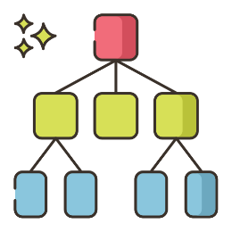









What is model tuning?
Model tuning is the process of finding the best model with internal correct configurations to give us the highest possible accuracy we can achieve
Accuracy: 89%
Accuracy: 92%
Accuracy: 95%

Slide 14
Model Tuning Terminologies
<Topic>

Slide 15
Model Tuning Terminologies
There are a few terminologies we need to know before understanding model tuning
Bias
Variance
Underfitting
Overfitting
Bias can be described as the inability of a model to capture the true relationship in the data

Slide 16
Model Tuning Terminologies
There are a few terminologies we need to know before understanding model tuning
Bias
Variance
Underfitting
Overfitting
A model with high bias leads to a model performing poorly on both training set and testing set

Slide 17
Model Tuning Terminologies
There are a few terminologies we need to know before understanding model tuning
Bias
Variance
Underfitting
Overfitting
Variance is the difference of fit between different sets of data like training and testing set

Slide 18
Model Tuning Terminologies
There are a few terminologies we need to know before understanding model tuning
Bias
Variance
Underfitting
Overfitting
A model with high variance leads to a model performing well on training set and performing poorly on testing set

Slide 19
Model Tuning Terminologies
There are a few terminologies we need to know before understanding model tuning
Bias
Variance
Underfitting
Overfitting
Underfitting means that a model is too simple to capture the patterns within the data

Slide 20
Model Tuning Terminologies
There are a few terminologies we need to know before understanding model tuning
Bias
Variance
Underfitting
Overfitting
An underfit model performs poorly on data it has been trained on as well as unseen data

Slide 21
Model Tuning Terminologies
There are a few terminologies we need to know before understanding model tuning
Bias
Variance
Underfitting
Overfitting
Overfitting means that a model is too complex and basically memorizes the training set and thus performs poorly on testing sets

Slide 22
Model Tuning Terminologies
There are a few terminologies we need to know before understanding model tuning
Bias
Variance
Underfitting
Overfitting
An overfit model performs well on data it has been trained on but poorly on testing data

Slide 23
What is Hyperparameter Tuning?
<Topic>

Slide 24


What is Hyperparameter Tuning?
Hyperparameter Tuning is the process of finding the combination of hyperparameters that give us the best accuracy
Data
Algorithm
Accuracy: 89%
Accuracy: 92%
Accuracy: 95%
Hyper Parameters

Slide 25
Types of Hyperparameter tuning
<Topic>

Slide 26
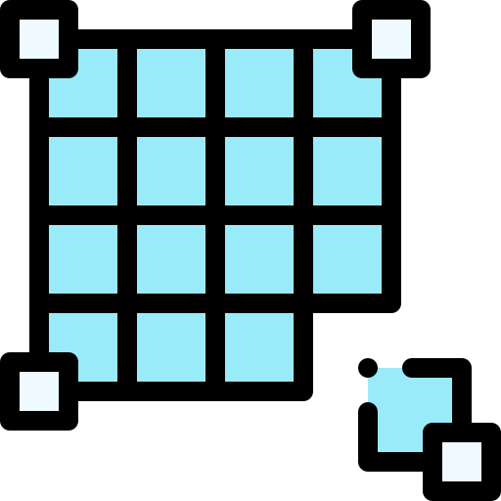

Types of Hyperparameter tuning
There are many types of Hyperparameter tuning, two of the most popular ones are
Grid Search
Random Search

Slide 27
Grid Search
<Topic>

Slide 28
Grid Search
In Grid Search Hyperparameter tuning we specify multiple hyperparameters for and try out all combinations of them

Slide 29
Grid Search
Let us take an example for training an GradientBoostingClassifier
GradientBoostingClassifier

Slide 30
Grid Search
We’ll be tuning two sets of hyperparameters named learn_depth with values [0.001, 0.01, 0.05] and max_depth with values [4, 6, 8]
 | 4 | 6 | 8
0.001
0.01
0.05
GradientBoostingClassifier

Slide 31
Grid Search
We will be checking all possible combinations of these hyperparameters and pick the one with the best accuracy
 | 4 | 6 | 8
0.001
0.01
0.05
GradientBoostingClassifier

Slide 32
Grid Search
We will be checking all possible combinations of these hyperparameters and pick the one with the best accuracy
 | 4 | 6 | 8
0.001 | 58%
0.01
0.05
GradientBoostingClassifier

Slide 33
Grid Search
We will be checking all possible combinations of these hyperparameters and pick the one with the best accuracy
 | 4 | 6 | 8
0.001 | 58% | 51%
0.01
0.05
GradientBoostingClassifier

Slide 34
Grid Search
We will be checking all possible combinations of these hyperparameters and pick the one with the best accuracy
 | 4 | 6 | 8
0.001 | 58% | 51% | 72%
0.01
0.05
GradientBoostingClassifier

Slide 35
Grid Search
We will be checking all possible combinations of these hyperparameters and pick the one with the best accuracy
 | 4 | 6 | 8
0.001 | 58% | 51% | 72%
0.01 | 62%
0.05
GradientBoostingClassifier

Slide 36
Grid Search
We will be checking all possible combinations of these hyperparameters and pick the one with the best accuracy
 | 4 | 6 | 8
0.001 | 58% | 51% | 72%
0.01 | 62% | 78%
0.05
GradientBoostingClassifier

Slide 37
Grid Search
We will be checking all possible combinations of these hyperparameters and pick the one with the best accuracy
 | 4 | 6 | 8
0.001 | 58% | 51% | 72%
0.01 | 62% | 78% | 65%
0.05
GradientBoostingClassifier

Slide 38
Grid Search
We will be checking all possible combinations of these hyperparameters and pick the one with the best accuracy
 | 4 | 6 | 8
0.001 | 58% | 51% | 72%
0.01 | 62% | 78% | 65%
0.05 | 81%
GradientBoostingClassifier

Slide 39
Grid Search
We will be checking all possible combinations of these hyperparameters and pick the one with the best accuracy
 | 4 | 6 | 8
0.001 | 58% | 51% | 72%
0.01 | 62% | 78% | 65%
0.05 | 81% | 92%
GradientBoostingClassifier

Slide 40
Grid Search
We will be checking all possible combinations of these hyperparameters and pick the one with the best accuracy
 | 4 | 6 | 8
0.001 | 58% | 51% | 72%
0.01 | 62% | 78% | 65%
0.05 | 81% | 92% | 89%
GradientBoostingClassifier

Slide 41
Grid Search
We will be checking all possible combinations of these hyperparameters and pick the one with the best accuracy
 | 4 | 6 | 8
0.001 | 58% | 51% | 72%
0.01 | 62% | 78% | 65%
0.05 | 81% | 92% | 89%
GradientBoostingClassifier

Slide 42
Random Search
<Topic>

Slide 43
Random Search
In Random Search Hyperparameter tuning we specify multiple hyperparameters for and try out multiple combinations of them just not all combinations

Slide 44
Random Search
Let us again take the example for training a GradientBoostingClassifier
GradientBoostingClassifier

Slide 45
Random Search
We’ll be tuning two sets of hyperparameters named learn_depth with values [0.001, 0.01, 0.05] and max_depth with values [4, 6, 8]
 | 4 | 6 | 8
0.001
0.01
0.05
GradientBoostingClassifier

Slide 46
Random Search
But instead of checking all possible combinations we will randomly check only a subset of them and pick the best one
 | 4 | 6 | 8
0.001 | 58%
0.01
0.05
GradientBoostingClassifier

Slide 47
Random Search
But instead of checking all possible combinations we will randomly check only a subset of them and pick the best one
 | 4 | 6 | 8
0.001 | 58% | 51%
0.01
0.05
GradientBoostingClassifier

Slide 48
Random Search
But instead of checking all possible combinations we will randomly check only a subset of them and pick the best one
 | 4 | 6 | 8
0.001 | 58% | 51%
0.01 |  |  | 65%
0.05
GradientBoostingClassifier

Slide 49
Random Search
But instead of checking all possible combinations we will randomly check only a subset of them and pick the best one
 | 4 | 6 | 8
0.001 | 58% | 51%
0.01 |  |  | 65%
0.05 | 81%
GradientBoostingClassifier

Slide 50
Random Search
But instead of checking all possible combinations we will randomly check only a subset of them and pick the best one
 | 4 | 6 | 8
0.001 | 58% | 51%
0.01 |  |  | 65%
0.05 | 81% |  | 89%
GradientBoostingClassifier

Slide 51
Random Search
This method might not give us the best combination but will definitely give us a combination which gives great accuracy
 | 4 | 6 | 8
0.001 | 58% | 51%
0.01 |  |  | 65%
0.05 | 81% |  | 89%
GradientBoostingClassifier

Slide 52
Random Search
This method might not give us the best combination but will definitely give us a combination which gives great accuracy
 | 4 | 6 | 8
0.001 | 58% | 51%
0.01 |  |  | 65%
0.05 | 81% |  | 89%
GradientBoostingClassifier

Slide 53
Principal Component Analysis
<Topic>

Slide 54
Principal Component Analysis
Most common form of factor analysis
The new variables/dimensions
Are linear combinations of the original ones
Are uncorrelated with one another
Orthogonal in original dimension space
Capture as much of the original variance in the data as possible
Are called Principal Components

Slide 55
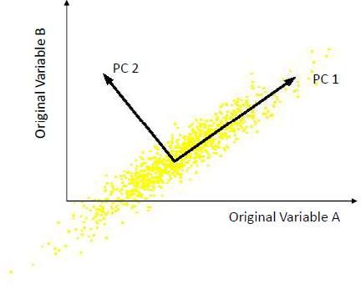
What are the new axes?
Orthogonal directions of greatest variance in data
Projections along PC1 discriminate the data most along any one axis

Slide 56
Principal Components
First principal component is the direction of greatest variability (covariance) in the data
Second is the next orthogonal (uncorrelated) direction of greatest variability
– So first remove all the variability along the first component, and then find the next direction of greatest variability
And so on …

Slide 57
Principal Components Analysis (PCA)
Principle
Linear projection method to reduce the number of parameters
Transfer a set of correlated variables into a new set of uncorrelated
variables
Map the data into a space of lower dimensionality
Form of unsupervised learning
Properties
It can be viewed as a rotation of the existing axes to new positions in the space defined by original variables
New axes are orthogonal and represent the directions with maximum variability

Slide 58
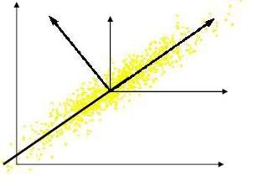
Computing the Components
Data points are vectors in a multidimensional space
Projection of vector x onto an axis (dimension) u is u.x
Direction of greatest variability is that in which the average square of the projection is greatest
I.e. u such that E((u.x)2) over all x is maximized
(we subtract the mean along each dimension, and center the original axis system at the centroid of all data points, for simplicity)
This direction of u is the direction of the first Principal Component

Slide 59
Computing the Components
E((u.x)2) = E ((u.x) (u.x)T) = E (u.x.x T.uT)
The matrix S = x.xT contains the correlations (similarities) of the original axes based on how the data values project onto them
So we are looking for w that maximizes uSuT, subject to u being unit-length
It is maximized when w is the principal eigenvector of the matrix S, in which case
uCuT = uλuT = λ if u is unit-length, where λ is the principal eigenvalue of the correlation matrix C
The eigenvalue denotes the amount of variability captured along that dimension

Slide 60
Why the Eigenvectors?
Maximise uTxxTu s.t uTu = 1 Construct Langrangian uTxxTu – λuTu
Vector of partial derivatives set to zero
xxTu – λu = (xxT – λI) u = 0
As u ≠ 0 then u must be an eigenvector of xxT with eigenvalue λ

Slide 61
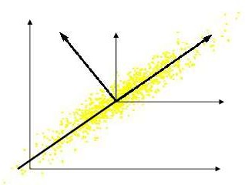
Computing the Components
Similarly for the next axis, etc.
So, the new axes are the eigenvectors of the matrix of correlations of the original variables, which captures the similarities of the original variables based on how data samples project to them
Geometrically: centering followed by rotation
– Linear transformation

Slide 62
PCs, Variance and Least-Squares
The first PC retains the greatest amount of variation in the sample
The kth PC retains the kth greatest fraction of the variation in the sample
The kth largest eigenvalue of the correlation matrix C is the variance in the sample along the kth PC
The least-squares view: PCs are a series of linear least squares fits to a sample, each orthogonal to all previous ones

Slide 63
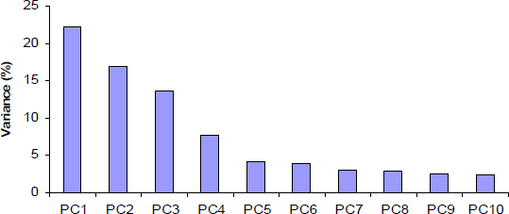
Dimensionality Reduction
Can ignore the components of lesser significance.
You do lose some information, but if the eigenvalues are small, you don’t lose much
n dimensions in original data
calculate n eigenvectors and eigenvalues
choose only the first p eigenvectors, based on their eigenvalues
final data set has only p dimensions

Slide 64


Thank You

